Slide 1

Top 1000 MOVIES
Skip to content
Resource Kaggle.com
February 3rd 2022
UCI Bootcamp
Mango5 Project

Slide 2
Presented by
James Yoo
Samuel Park
Elliott Einstein
Sally Ahmed
Anthony Taylor
Mark Flynn
Data Analysist bootcamp
Project 1

Slide 3
IMDB Movies Dataset
Series_Title Released_Year Certificate Runtime Genre IMDB_Rating Overview Meta_score Director
Stars Noofvotes Gross
February 3rd 2022
THE GENERAL
ADMIT ONE
Data Analysist bootcamp
Project 1

Slide 4
General information's
MetaScore
The Metascore comes from Metacritic - Movie Reviews, TV Reviews, Game Reviews, and Music Reviews, which is a one-stop place to find professional reviews from most of the movie critics from publications in the US.
IMDB Rating
IMDb registered users can cast a vote (from 1 to 10) on every released title in the database. Individual votes are then aggregated and summarized as a single IMDb rating, visible on the title's main page. By "released title" we mean that the movie (or TV show) must have been shown publicly at least once (including festival screening).

Slide 5
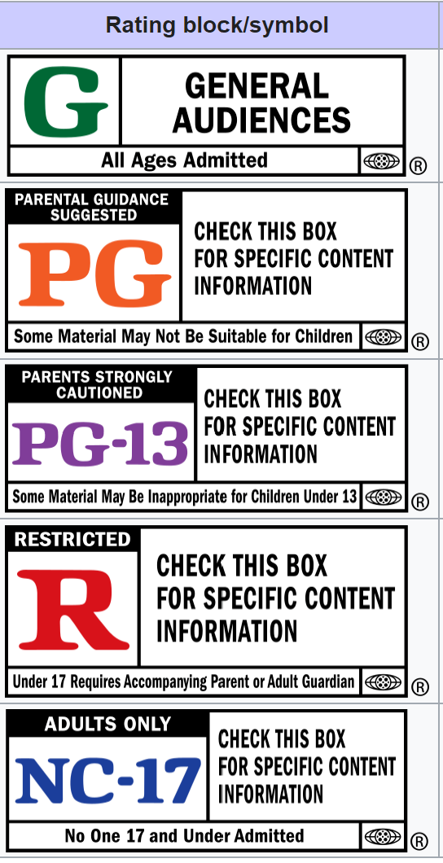
Movie Certificate
Motion Picture Association film rating system
G – General Audiences
PG – Parental Guidance Suggested
PG-13 – Parents Strongly Cautioned
R – Restricted
NC-17 – Adults Only

Slide 6
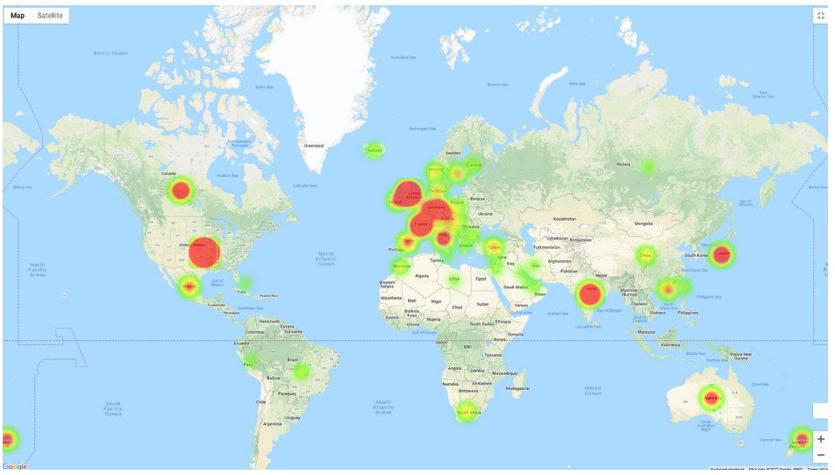
Mapping
Where is the mecca of Movie production?

Slide 7
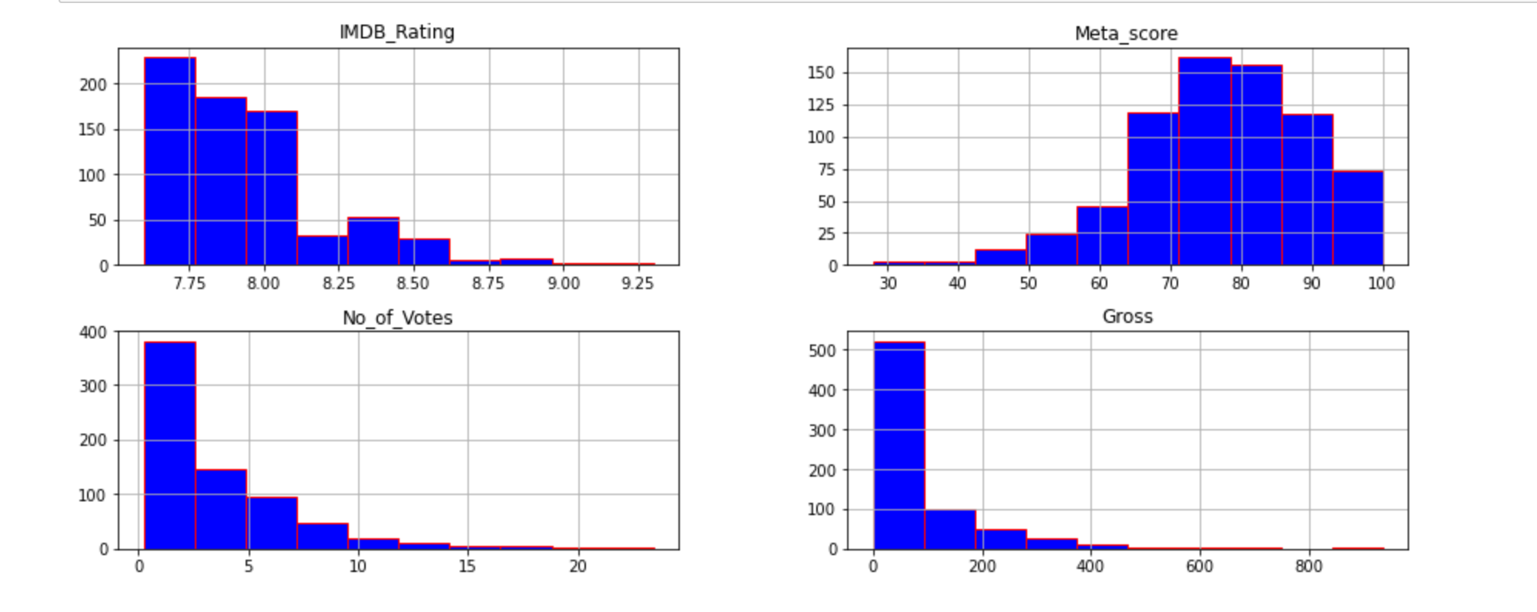
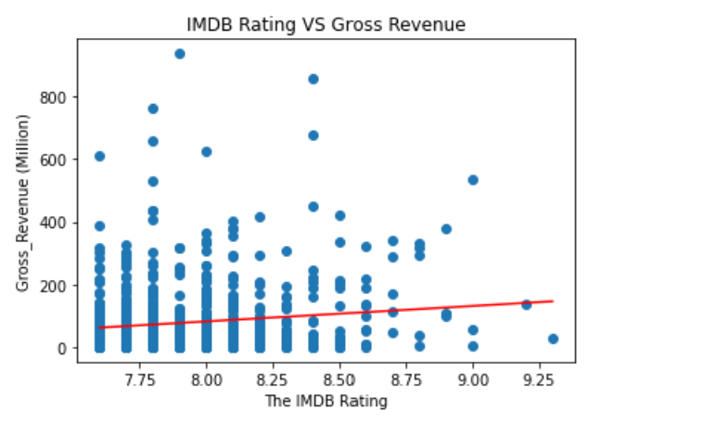

Slide 8
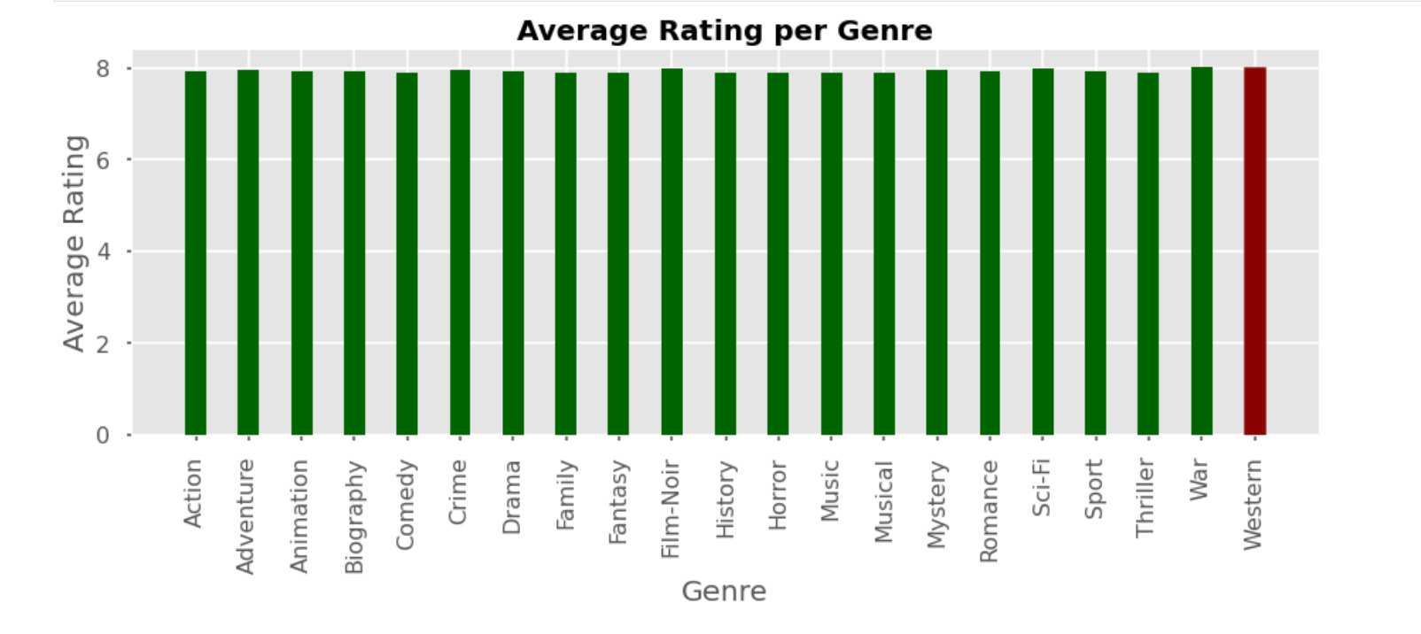
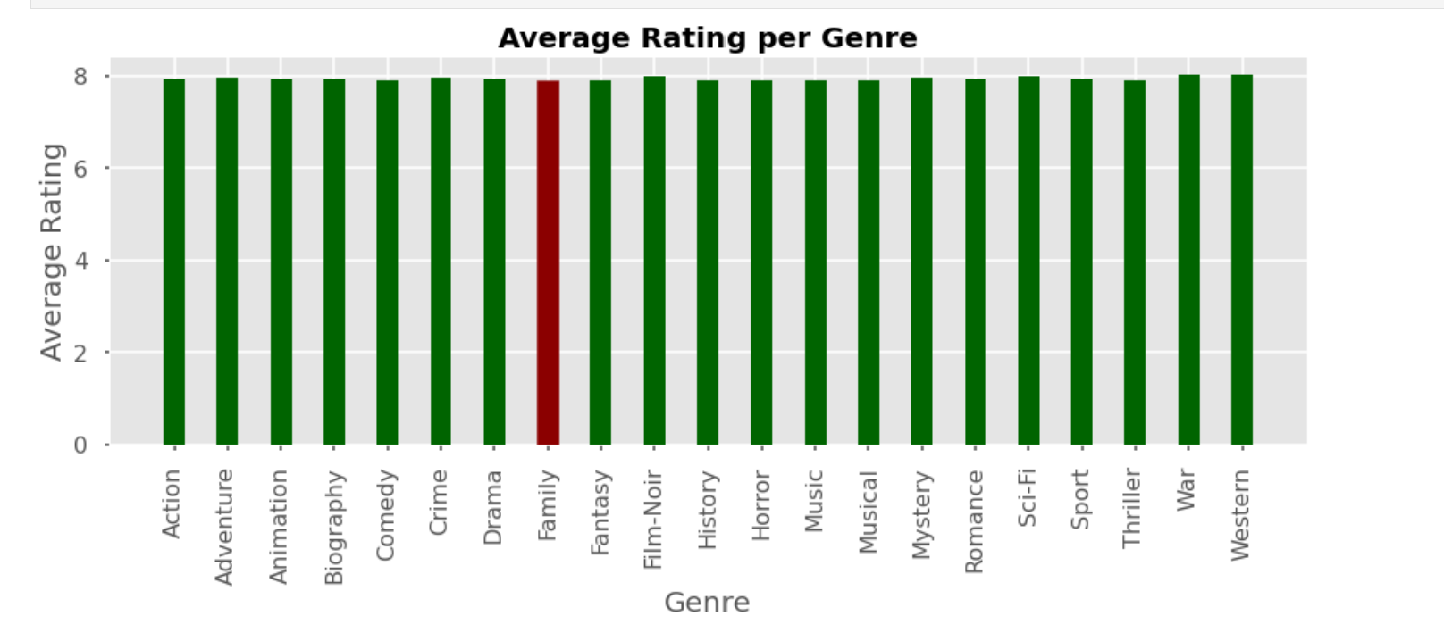


Which movie genre is the highest rated and which movie genre is the least rated?

Slide 9
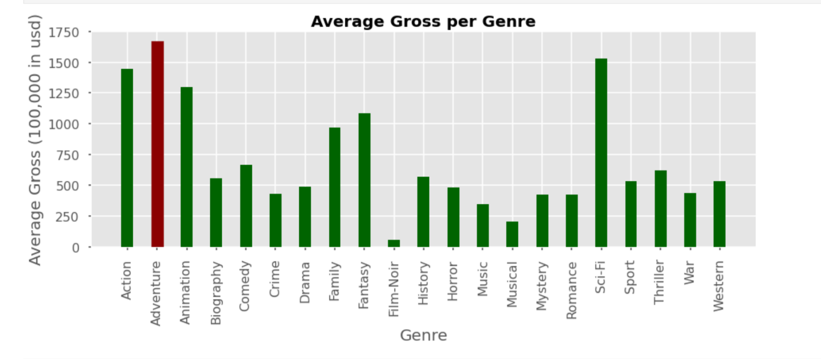
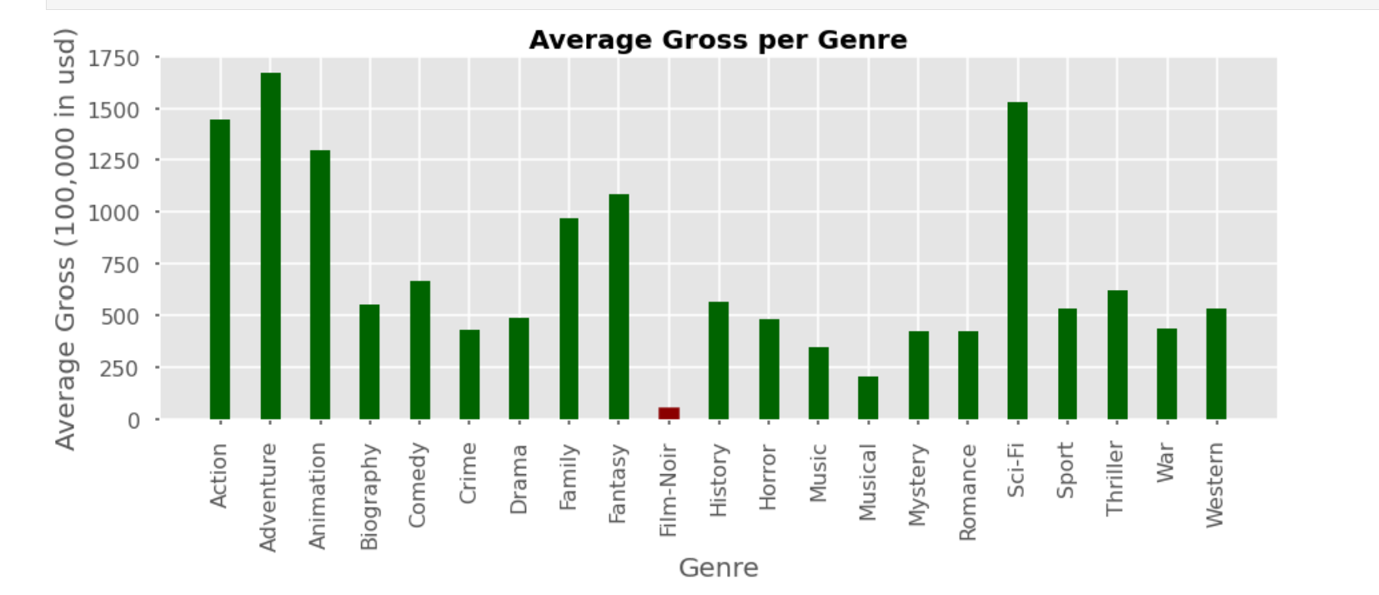
Which movie genre makes the highest gross income and which movie genre makes the least?

Slide 10
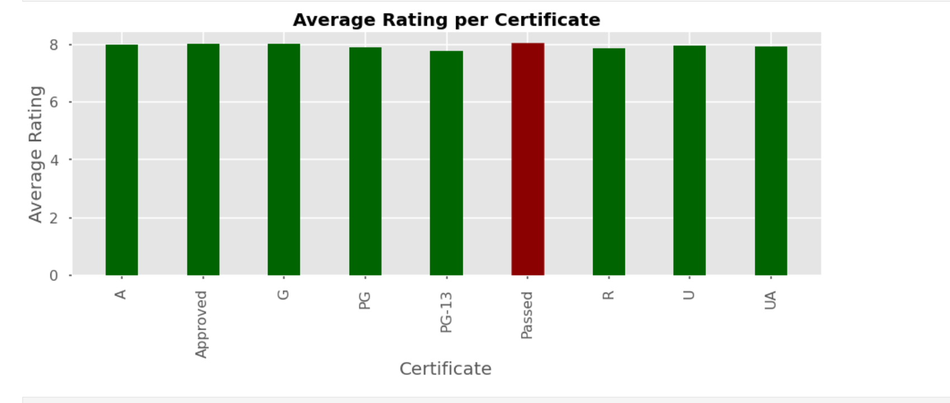
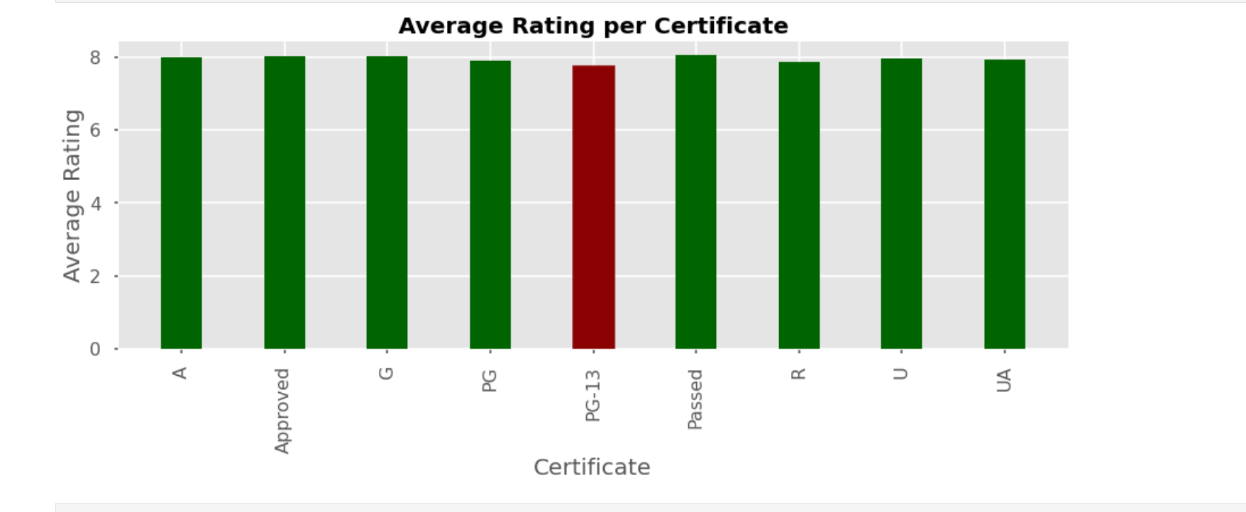
Which movie certificate is the highest rated and which movie certificate is the least rated?

Slide 11
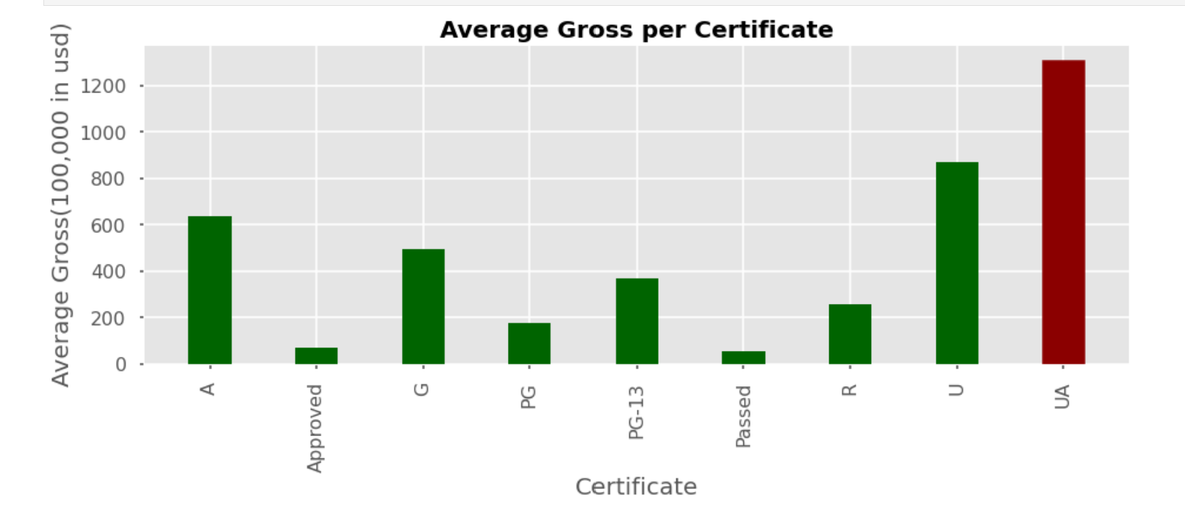
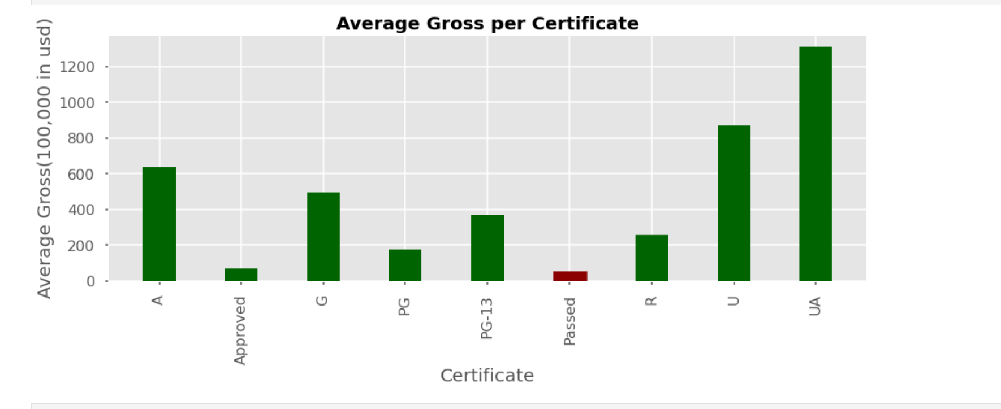
Which movie certificate makes the highest gross income and which movie certificate makes the least?

